Slide 1
Automating ML with PyCaret
Making Machine Learning Simple & Fast

Slide 2

About Me
Manjunath Janardhan, Principal AI Engineer at MSG Global
21+ years of software engineering experience
Key expertise areas: Gen AI Solutions, Microservices & Cloud
Patent Holder
Speaker, Medium Articles, YouTuber (3 channels).
Notes:
This slide serves as an introduction to my professional background and journey. I will cover my educational background, work experiences, and the skills I've developed. Additionally, I will share my interests and passions within the industry. The LinkedIn QR code will facilitate networking, and the portfolio link will provide insights into my work and projects.

Slide 3

Agenda
Introduction to ML and PyCaret Fundamentals
Live Demo: Training Models with the Diabetes Dataset
Live Demo: Comparing Models for Best Performance
Live Demo: Model Persistence & Deployment
Interactive Q&A Session

Slide 4
Introduction to Machine Learning
Machine Learning (ML): Algorithms enable computers to learn from data and make predictions or decisions.
Typical ML Workflow:
Data preprocessing
Model selection and training
Evaluation
Deployment
Challenges: Complexity, need for coding, time-consuming setup.

Slide 5
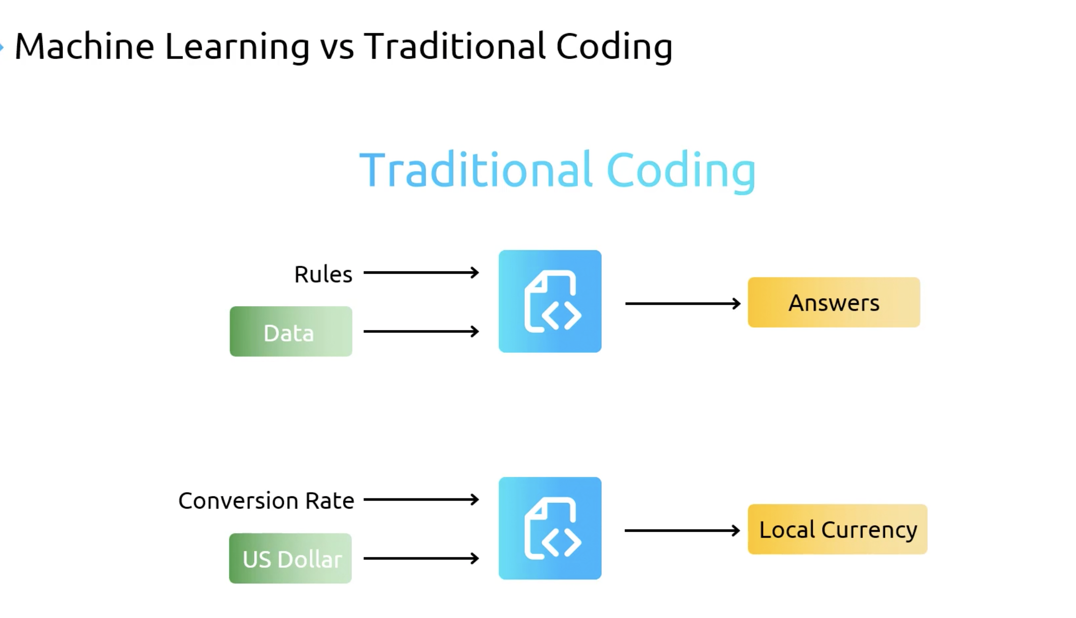

Slide 6
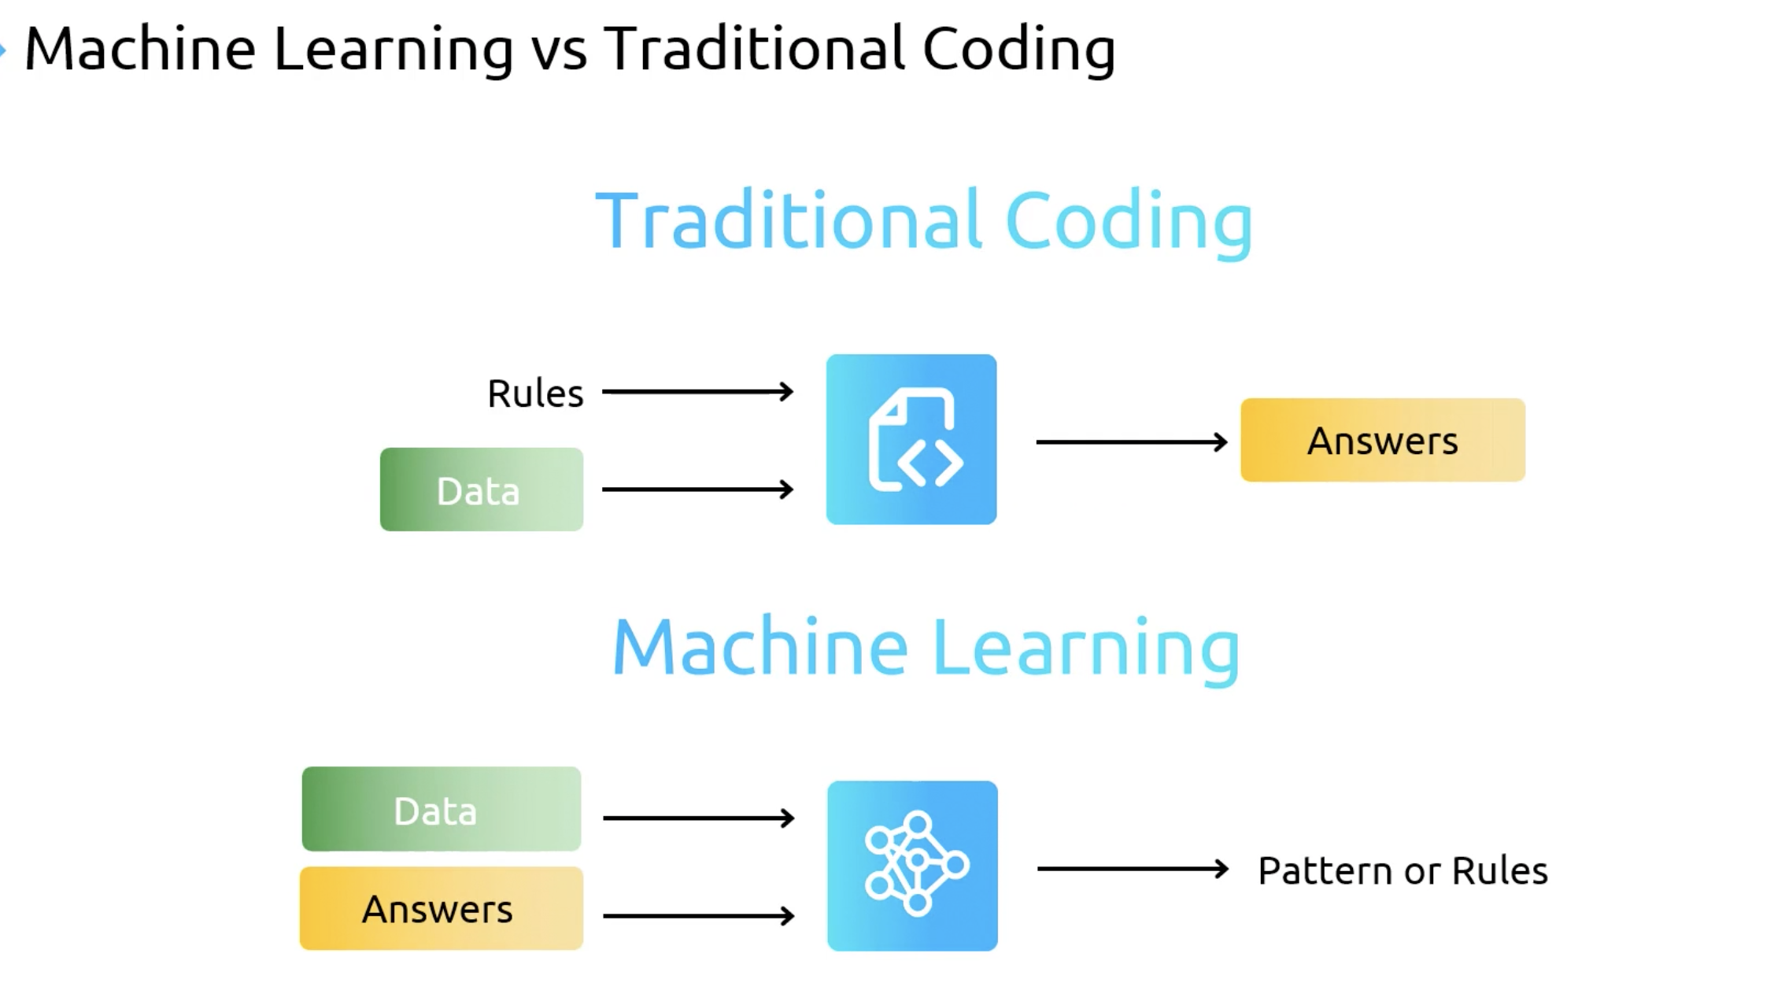

Slide 7
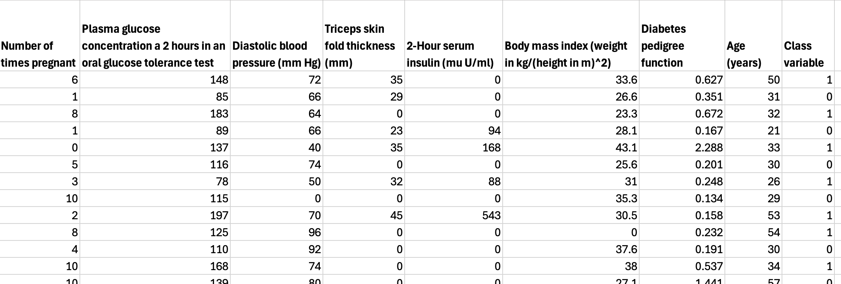
Diabetes Dataset

Slide 8
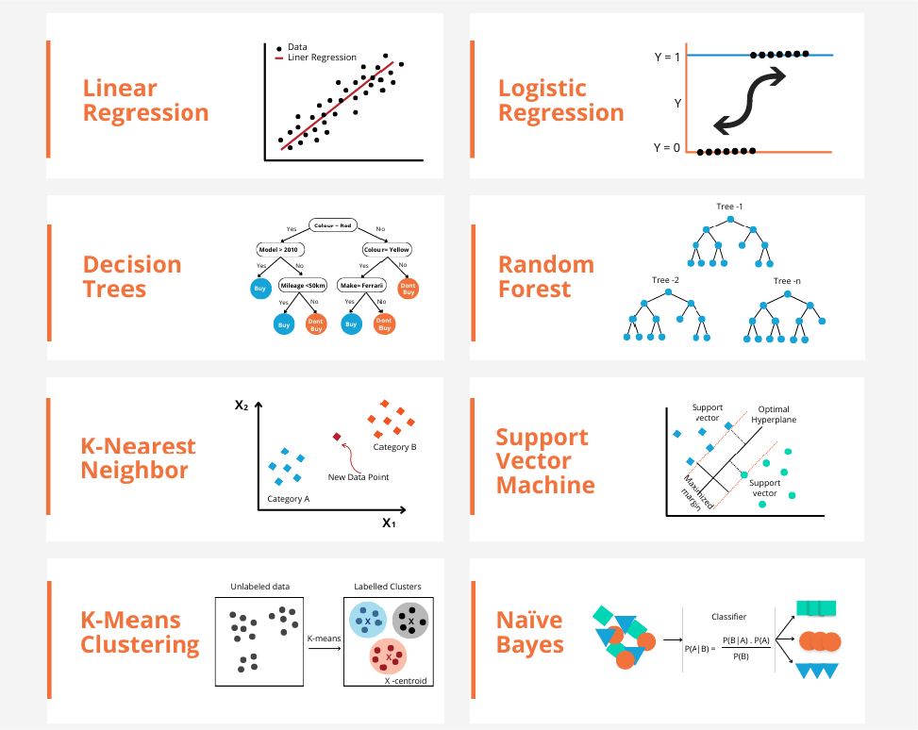

Slide 9
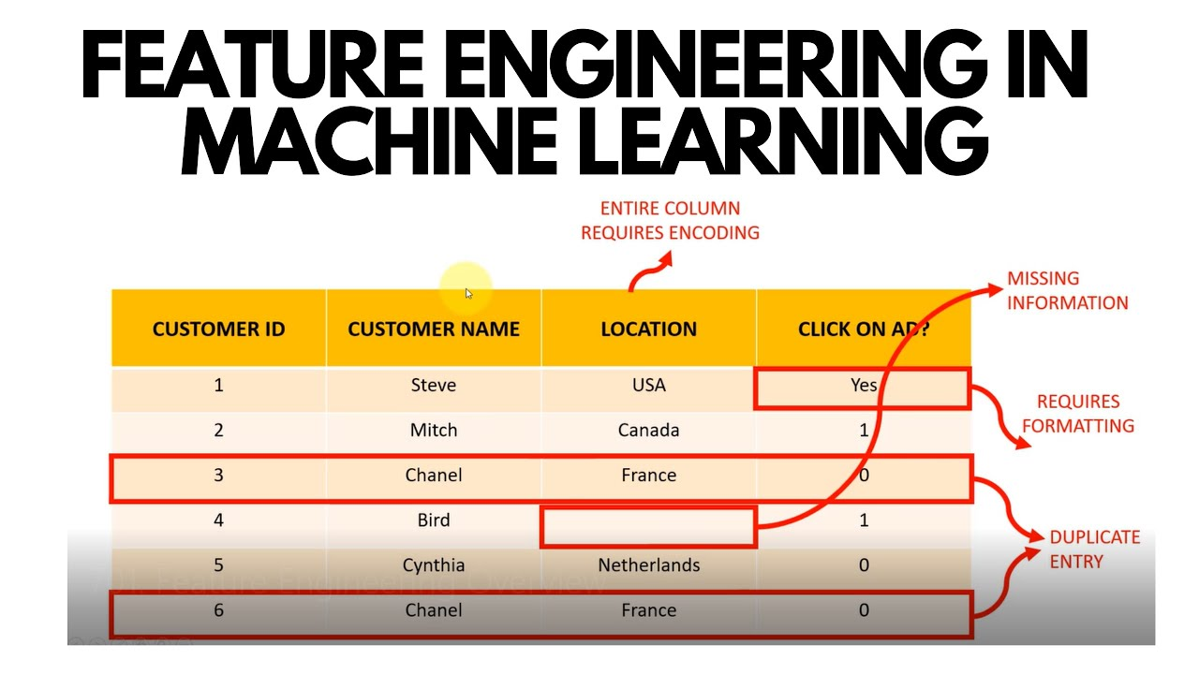

Slide 10
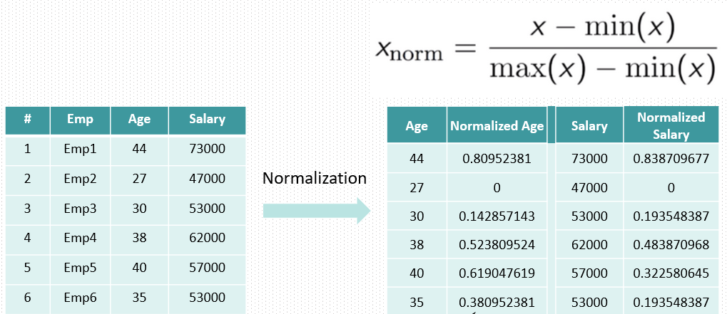
Feature Scaling

Slide 11
Your First ML Program: LINEAR Regression
from sklearn.linear_model import LinearRegression
from sklearn.model_selection import train_test_split
# Split data
X_train, X_test, y_train, y_test = train_test_split(X, y, test_size=0.3, random_state=42)
# Create and train model
model = LinearRegression()
model.fit(X_train, y_train)
# Make predictions
y_pred = model.predict(X_test)

Slide 12
Your First ML Program: Logistic Regression
from sklearn.linear_model import LogisticRegression
from sklearn.model_selection import train_test_split
# Split data
X_train, X_test, y_train, y_test = train_test_split(X, y, test_size=0.3, random_state=42)
# Create and train model
model = LogisticRegression() model.ﬁt(X_train, y_train)
# Make predictions
y_pred = model.predict(X_test)

Slide 13
Evaluating Models in Python
from sklearn.metrics import confusion_matrix, classiﬁcation_report
from sklearn.metrics import roc_curve, roc_auc_score
# Get probability predictions
y_prob = model.predict_proba(X_test)[:, 1]
# Confusion matrix
cm = confusion_matrix(y_test, y_pred) print(f"Confusion Matrix:\n{cm}")
# Classiﬁcation report
print(classiﬁcation_report(y_test, y_pred))
# ROC curve and AUC
fpr, tpr, _ = roc_curve(y_test, y_prob)
auc = roc_auc_score(y_test, y_prob) print(f"AUC: {auc:.2f}")

Slide 14
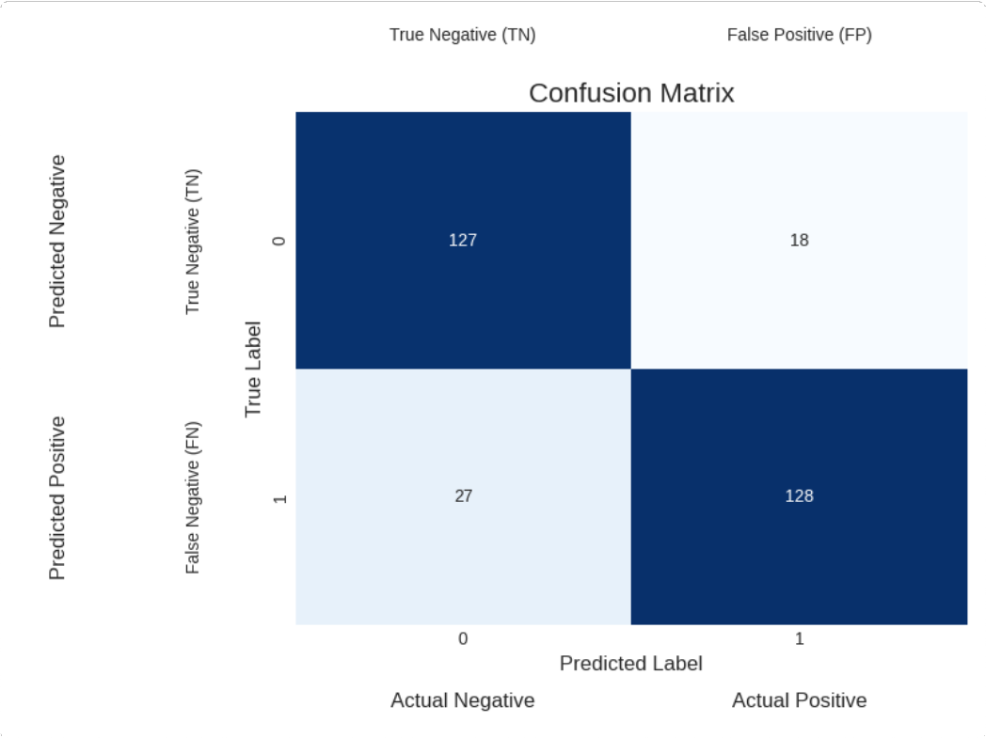
Evaluation Metrics: Beyond Accuracy
Key Metrics:
Precision = TP/(TP+FP) How many positive predictions were correct
Recall = TP/(TP+FN) How many actual positives were found
F1 Score = 2* (Precision*Recall)/(Precisio Harmonic mean of precision and recall
Accuracy = (TP+TN)/(TP+TN+FP+FN)
Overall correctness

Slide 15
Why PyCaret?
Low-code, fast ML experimentation in Python
Clean API for training, comparing, and tuning models
Automation of preprocessing, imputation, and feature selection
Multiple model benchmarking with one command

Slide 16
Live Demo – Training Models (Diabetes Dataset)
Dataset: Diabetes dataset with health metrics and outcome label.
Features:
Pregnancies, glucose, blood pressure, BMI, age, etc.
Goal: Predict diabetes onset.
PyCaret Workflow:
Import module and datasets
Setup environment
Train models using multiple algorithms with one line of code

Slide 17
PyCaret vs MLOps Tools
Feature | PyCaret | MLflow | Metaflow
Primary Use | Low-code ML development | Model tracking, deployment | Workflow orchestration
Model Training | ✅ Yes | ❌ No | ❌ No
Experiment Logging | Basic (opt-in) | ✅ Full logging | ✅ Supports via integrations
Feature Engineering | ✅ Basic built-in | ❌ Not included | ❌ Not included
Scale / Parallel Training | ❌ Limited | ✅ With plugins | ✅ Supports DAGs
Deployment Support | Basic (pickle export) | ✅ REST, batch, registry | ✅ via AWS, Argo, etc.

Slide 18
Key Takeaways
PyCaret streamlines the entire ML workflow
Enables efficient model development and testing
Supports easy model comparison, persistence, and deployment
Great for rapid prototyping and education!

Slide 19
Resources
Github : https://github.com/pycaret/pycaret
Docs : https://pycaret.readthedocs.io/en/stable/
Dataset : https://github.com/pycaret/pycaret/blob/master/datasets/diabetes.csv
Demo : https://github.com/manjunathshiva/PythonMeetup

Slide 20



THANK YOU
https://www.youtube.com/@AIBroEnglish
https://www.youtube.com/@AIBroKannada
LinkedIn

